Slide 1
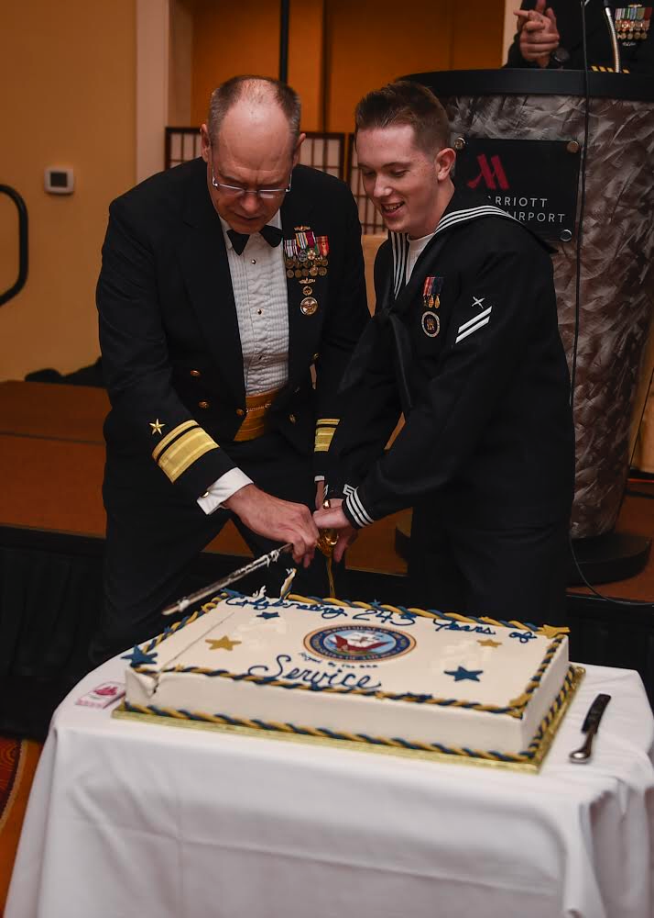
About me…
DoD/IC Contractor
U.S. Military Veteran
Built/Exited a Digital Firm
Open-Source Contributor
Career of Software/DevOps
Active Volunteer FF/EMT
Zack Brady – Field Engineer zack.brady@rancherfederal.com

